Slide 1

VIDEO GAMES
SALES ANALYSIS

Slide 2





TEAM MEMBERS
GROUP 3
KUSHAL THEROKAR
NIMESH WANKHEDE
SNEHAL KAMBLE
VAMSHI K. PERABATHULA

Slide 3

TABLE OF CONTENTS
OBJECTIVE
DATA PREPARATION
DATA EXPLORATION
VISUALIZATION
ML MODEL
SUMMARY
FUTURE WORK

Slide 4


OBJECTIVE
This research aims to study a dataset about video game sales to find out important information for people in the gaming industry, like game makers and sellers. The dataset includes details about games, like their names, platforms, release years, type and how many copies they sold in different parts of the world. We want to figure out which types of games are most popular, which game systems make the most money, and how these things have changed over time.

Slide 5

DATA PREPARATION

Slide 6
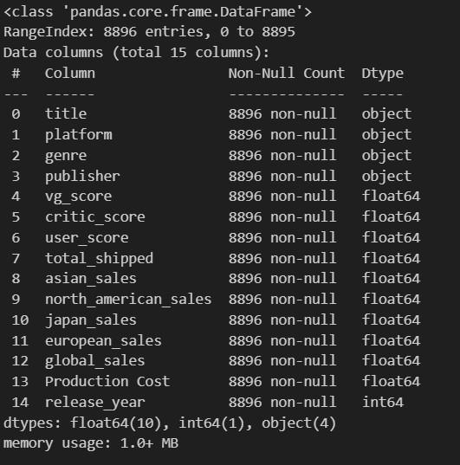
INFORMATION OF DATA

Slide 7
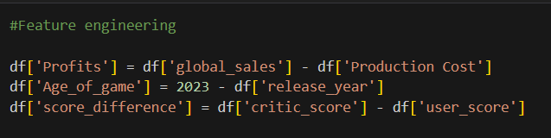
FEATURE ENGINEERING

Slide 8
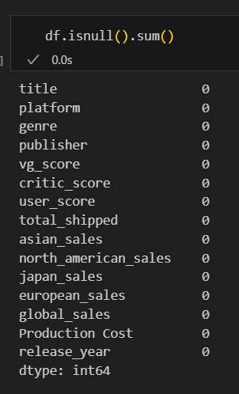
MISSING VALUES

Slide 9
DATA EXPLORATION

Slide 10
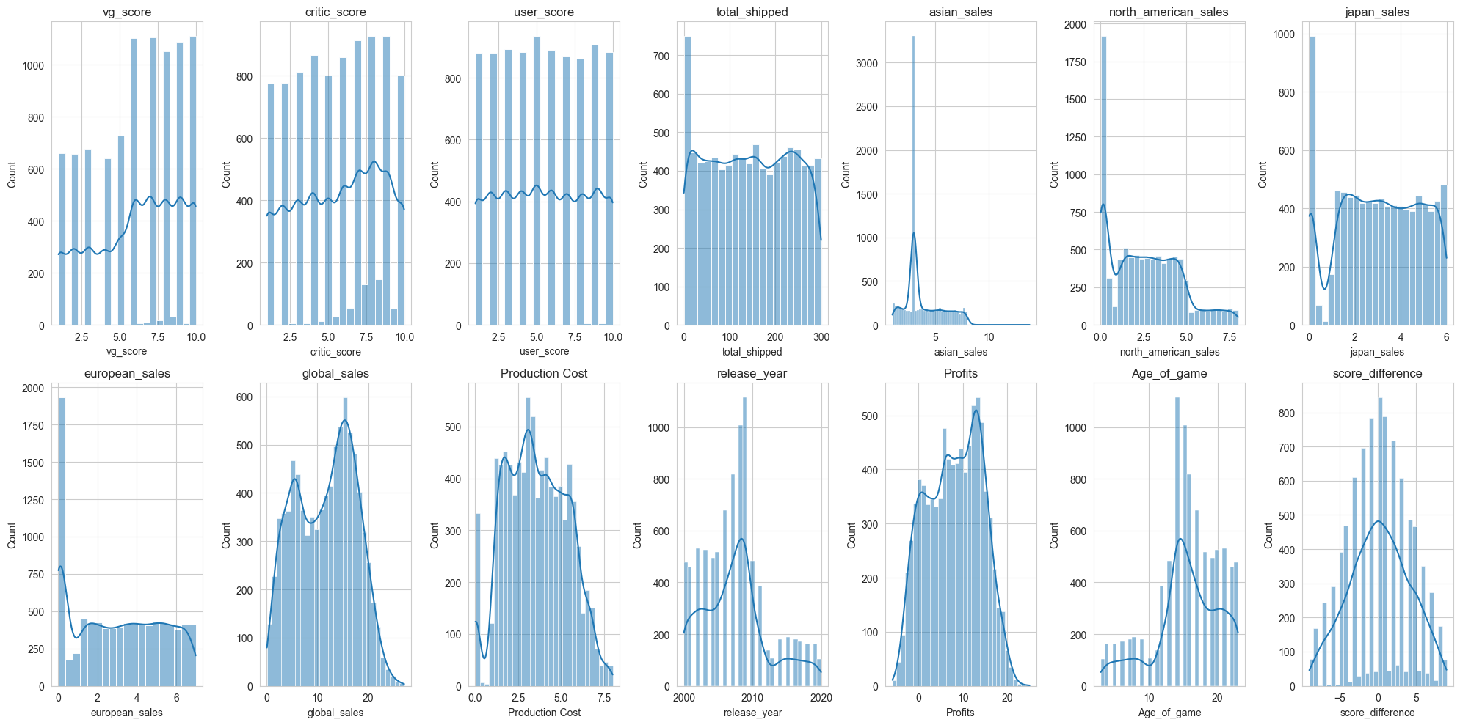
DISTRIBUTION OF NUMERIC COLUMNS

Slide 11
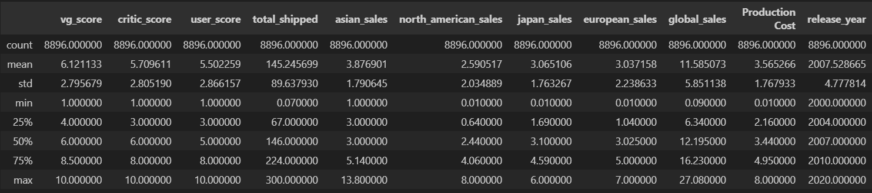
STATISTICS OF NUMERIC COLUMNS

Slide 12
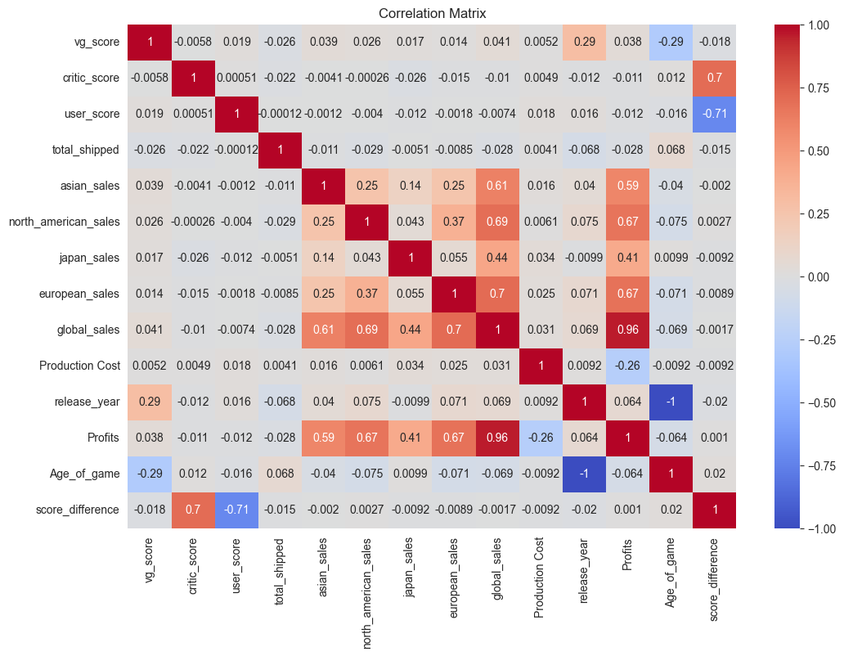
CORRELATION HEATMAP

Slide 13
VISUALIZATION

Slide 14
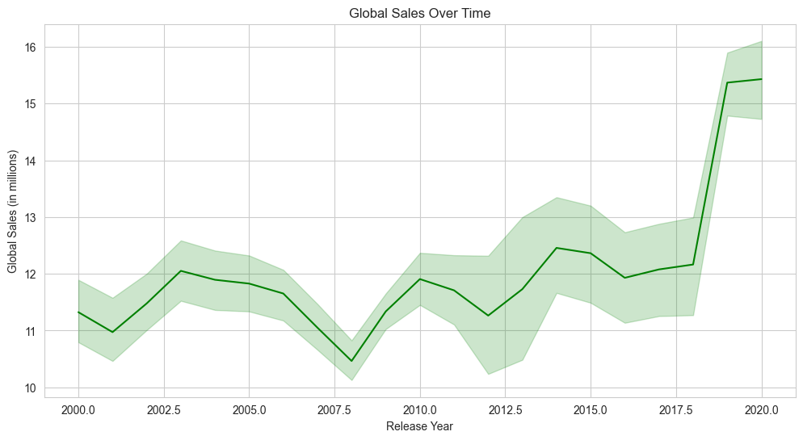
VISUALIZATION
LINE PLOT

Slide 15
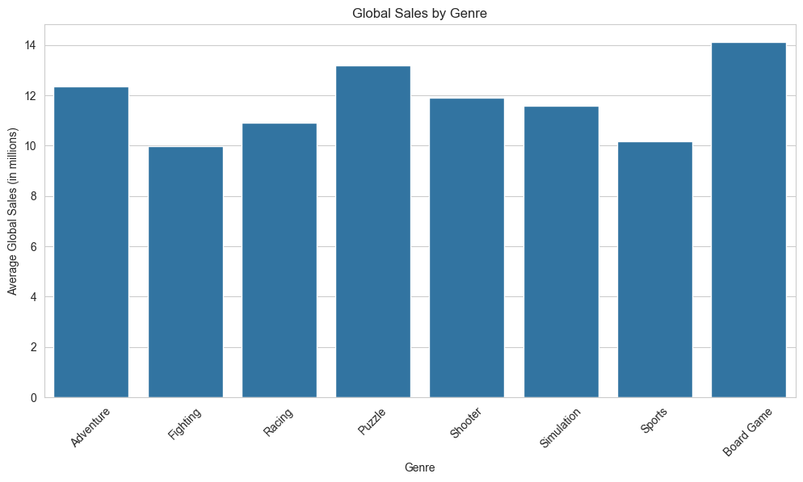
VISUALIZATION
HISTOGRAM

Slide 16
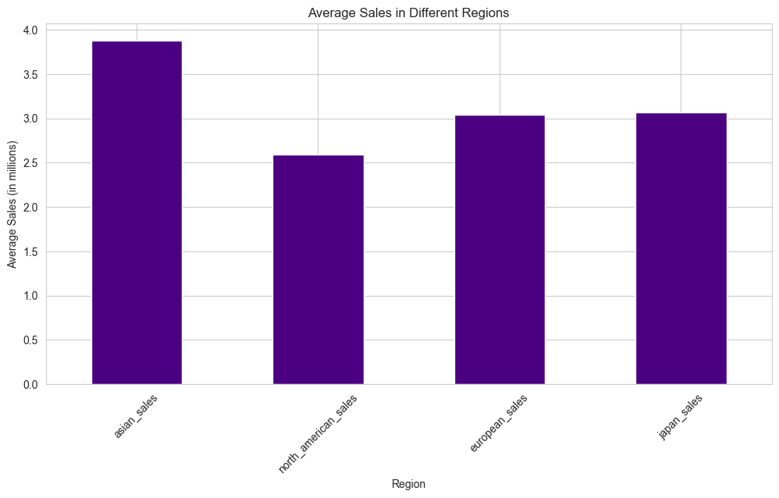
VISUALIZATION
HISTOGRAM

Slide 17
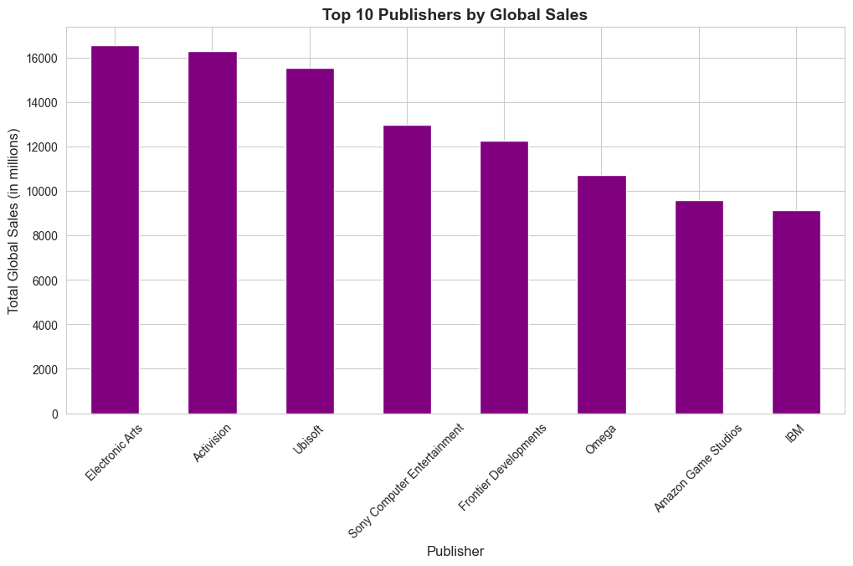
VISUALIZATION
HISTOGRAM

Slide 18
ML MODELS

Slide 19
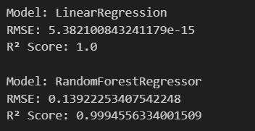
ML MODELS

Slide 20
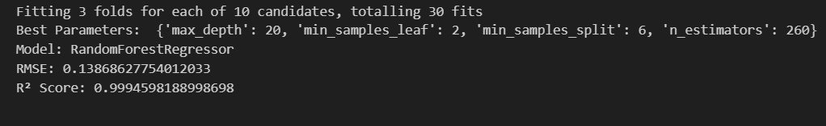
HYPERPARAMETER TUNING

Slide 21

SUMMARY

Slide 22

Data Completeness The dataset is robust with no missing values, ensuring a reliable analysis.
Sales Distribution: Global sales have a wide distribution, with most games selling at lower volumes but some outliers achieving very high sales.
Score Distribution: There's a broad spread in video game scores and critic scores, suggesting a diverse range of game quality and reception.
Production Costs vs. Sales: By calculating profits, we see a measure of financial success beyond just sales figures.
Game Age: The dataset includes games of various ages, which allows analysis of sales trends over time.

Slide 23

FUTURE WORK
Predictive Modeling: Develop models to forecast game sales based on scores, genre, and publisher.
Customer Segmentation: Analyze player data to tailor games to specific segments of the market.
Optimization of Production Costs: Look into ways to optimize production costs to maximize profits without compromising game quality.
Longitudinal Analysis: Study the impact of release timing and market conditions on sales.

Slide 24
THANK YOU!

